Slide 1
Inventory Management System
A Java application created by Melissa Potts

Slide 2
Contents
Project Overview
Technology Stack
Entity Relationship diagram
Project Tracking – Kanban board
Version Control System – GitHub
Risk Assessment
JUnit Testing
Demo
Future Improvements

Slide 3
Project Overview
The aim of this project was to create a java application which interacts with a database.
The application needed to be an inventory management system that is able to:
Create, Read, Update and Delete a customer.
A customer needs to have a name.
Create, Read, Update and Delete a product.
A product needs to have a name and value.
Create, Read and Delete an order.
An order needs to have a link to one customer and contains a value.

Slide 4



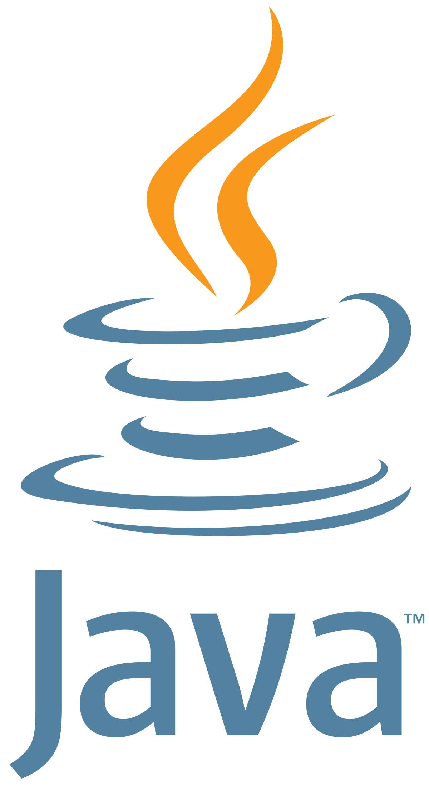


Technology Stack
Kanban Board: Trello
Database: MySQL Database
Programming language: Java
IDE: Eclipse
Testing framework: JUnit
Version Control system: Git
Host of version control system repository: GitHub

Slide 5
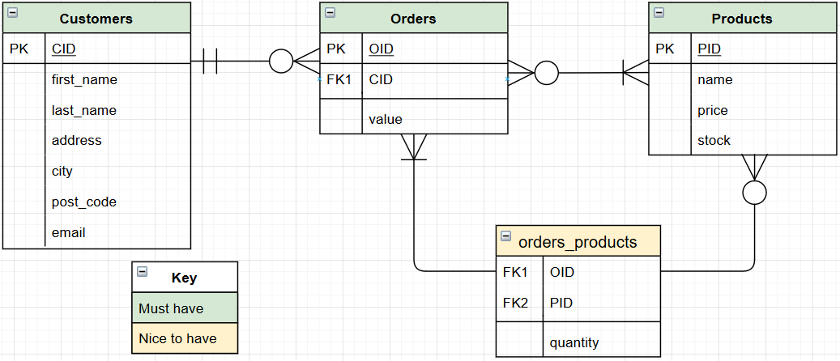
Entity Relationship Diagram

Slide 6
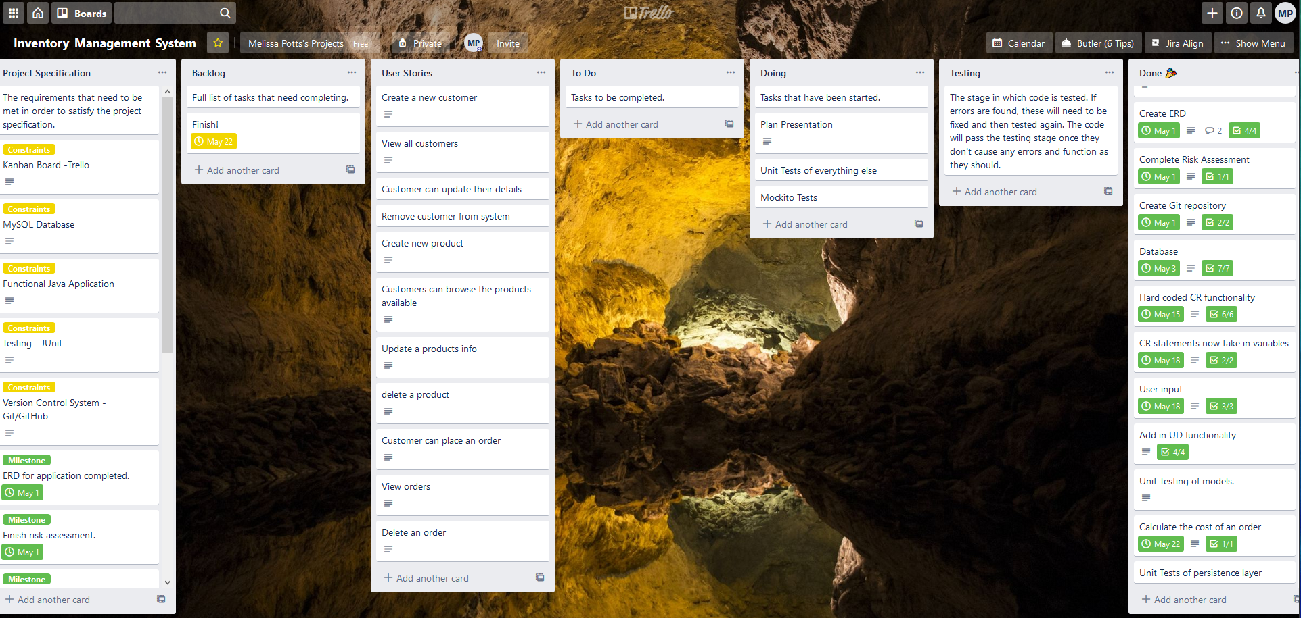
Project Tracking - Kanban Board
https://trello.com/b/lTUWwrPY/inventorymanagementsystem

Slide 7
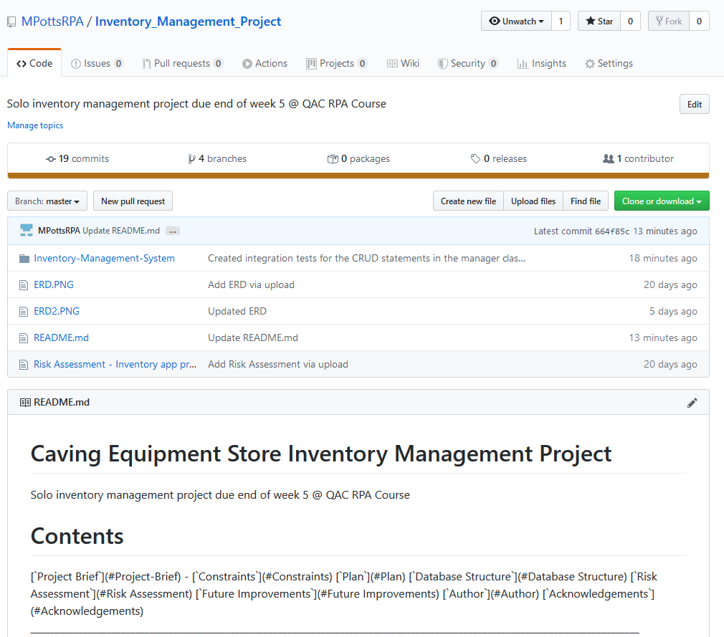
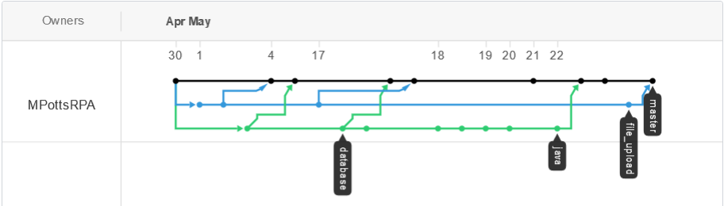
Version Control System - GitHub
I used GitHub to upload versions of my code to keep track of my progress.
I had separate branches for my java code, SQL database dump and file uploads.
Once I was happy with the content of the branches, I pushed them to the master branch.

Slide 8
Risk Assessment
Name | Description | Likelihood | Impact | Mitigation | Response
Product does not meet minimum viable product (MVP) requirements | Failed to meet some of the requirements set out in the project specification. This could be not having a working application at the end or not keeping the trello board up to date with my progress and user stories or not providing one of the deliverables. | Low | High | This links back to the planning stage. A good plan should help to avoid this risk by allocating the right amount of time to each element of the project and making sure all elements are accounted for. | Don't start working on any extra bits before getting the basic functionality working how it should.
Data breach due to being attacked by hackers | Hackers could read any info stored in database, including sensitive info such as passwords. If the user has used the same password for other sites, then they could be hacked further. | Low | High | Passwords should be hashed before being stored in the database. Also suggest to user when they are creating a password that they should use a different password to what they use for other services. | Users will be informed that there information could potentially be compromised and to change their password as soon as possible. Also tell the user that if they have used the same password for other services, to change it there too.
Data deleted by hackers | Individual tables could be deleted or the whole database could be lost. | Low | Medium | Make regular backups of the database. | If there are no backups of the database, then it would have to be reconstructed. Users would have to be informed in some way that they'll have to create a new account.

Slide 9
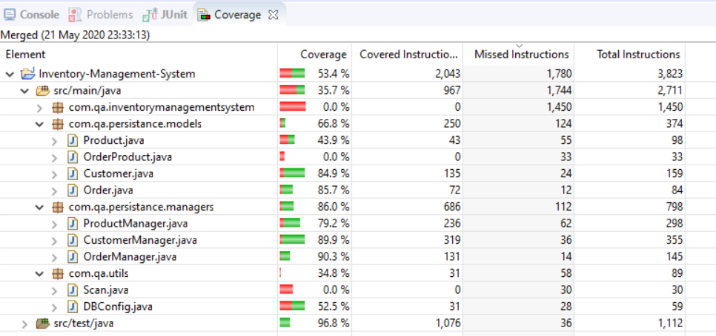
JUnit Testing
I implemented some basic integration tests using JUnit to test the CRUD queries and the models.

Slide 10
Demo

Slide 11
Future Improvements
Orders_Products table
Associate a product with an order
Can add multiple products to an order
Ability to log in as a customer or an admin
Means a customer can't edit things they shouldn’t (e.g. create, update or delete a product)

Slide 12
Thank you for Listening!
Is there any questions?

